Slide 1
Blog Application
Task - 2

Slide 2

Blog Application
A blog website allows users to opine their thoughts and comment on anything and everything. You can make a creative website or application using full-stack technology and take inspiration from other blogs. Ensure that you add proper authentication features so individuals with valid credentials can login to the platform.
LMS Username | Name | Batch
2115a515 | Jagadeesh K | A5
2115a53 | Akash NK | A5
2115a58 | Challa Sreenath | A5
2115a553 | Venkata Kiran Kumar | A5

Slide 3
Task - 2
Create UI and implement various components using react
Split design into components and Higher order Components
Define structure of the components
Set the basic ui components with dummy data
Integrate the APIs to frontend to ensure the dynamic feature of website
Point base api to the severs base url
Design api calls for each element
Handle errors in the output
Render output of apis to different low level components
Secure content of post apisx
Evaluation Metric:
100% Completion of the above tasks
Learning Outcome
Developing complicated UI using react components
Using props drilling and context to pass variables
Getting familiar with different type of api calls
Handling different input data

Slide 4
Step-Wise Description
Define the purpose and goals of the Stock Inventory Management System. Determine the features and functionality required to achieve these goals.
Plan the layout of the frontend page, including the main screen and various forms for adding, editing, and deleting items.
Design the layout using HTML and CSS, creating the necessary elements such as text fields, buttons, and tables.
Add JavaScript code to create the functionality for adding, editing, and deleting items. Use event listeners to trigger the code when the user interacts with the page.
Test the frontend page thoroughly to ensure that all functionality is working correctly.
Summary of your task
The task was to design a frontend page for a Stock Inventory Management System that included adding, editing, and deleting items using HTML and JavaScript.
The frontend page was designed using HTML and CSS to create the layout and styling, while JavaScript was used to create the functionality for adding, editing, and deleting items.

Slide 5
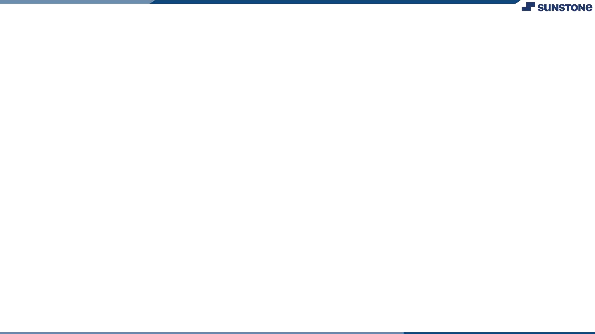

Assessment Parameter
Setup Project for Blog
Application
Setup basic structure of blog
application project
Create a main component with the
outer structure of blog
Check-List
Create main component with all feature buttons
Create a button component with on click handler
Create a JSON object to store data for blog application project
Create a ` addArticle()` function
to add article
Push both code to github

Slide 6


Submission Github
https://github.com/Sreenath777

Slide 7


